Slide 1
An Introduction to SQL
Chapter 4

Slide 2
What will you learn?
What you will learn?
  Why SQL?
  Query
  --Basic Structure
  --Set Operations
  --Aggregate Functions
  --Null Values
  --Nested Subqueries
  --Views
  3. Modification of the Database
  4. Data Definition Language

Slide 3
1. Why SQL? …
SQL was initially developed by IBM round 1976.
It has clear link to relational algebra.
SQL includes both data definition operations and data manipulation operations.
  Data definition language (DDL)
  Data manipulation language (DML)
There are many different SQL implementations; available in Oracle, DB2,SQL Server, Sybase, Access, JDBC etc. Most are a superset of a subset of one of the standards (ISO, ANSI, BSI …)
Learn SQL and can learn most databases.
It can be embedded within other high-level programming languages such as C, Pascal and PL/I

Slide 4
Banking Example
branch (branch-name, branch-city, assets)
customer (customer-name, customer-street, customer-city)
account (account-number, branch-name, balance)
loan (loan-number, branch-name, amount)
depositor (customer-name, account-number)
borrower (customer-name, loan-number)

Slide 5
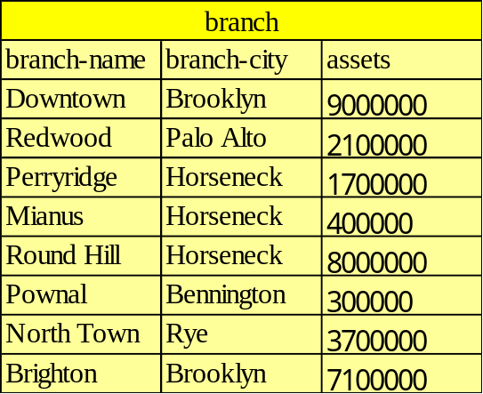
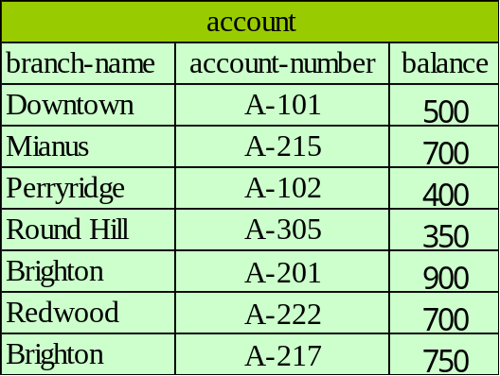
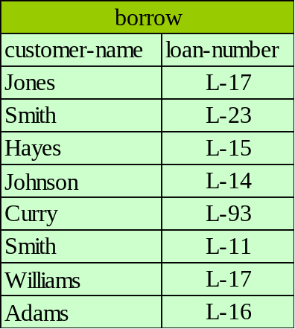
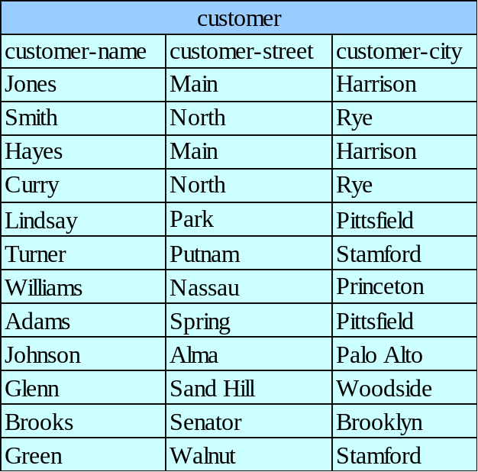
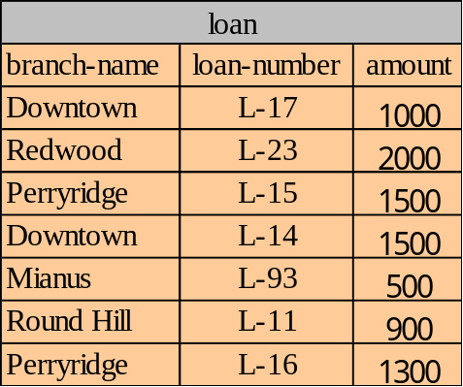
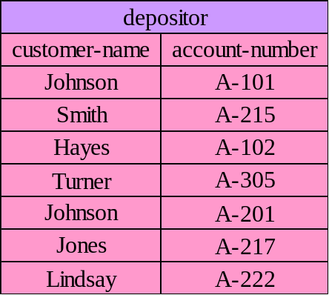
Banking Example

Slide 6
2. QUERY –basic structure
A typical SQL query has the form:
  select A₁, A₂, ..., A_{n}
  from r₁, r₂, ..., r_{m}
  where ρ;
The result of an SQL query is a relation.

Slide 7
2. Query-The select Clause
The select clause corresponds to the projection operation of the relational algebra. It is used to list the attributes desired in the result of a query.
e.g. Find the names of all branches in the loan relation.
select branch-name
from loan;
In the “pure” relational algebra syntax, the query would be: loan{branch-name}
An asterisk in the select clause denotes “all attributes”
select *
from loan;

Slide 8
2. Query -The select Clause…
SQL allows duplicates in relations as well as in query results.To force the elimination of duplicates, insert the keyword distinct after select.
e.g. Find the names of all branches in the loan relations, and remove duplicates
select distinct branch-name
from loan;
The keyword all specifies that duplicates not be removed.
select all branch-name
from loan;
The select clause can contain arithmetic expressions involving the operation,+,–,*,and /, and operating on constants or attributes of tuples.
e.g. select branch-name, loan-number, amount*100
from loan;

Slide 9
2. Query - The where Clause
The where clause corresponds to the selection predicate of the relational algebra.
and, or, not
e.g. Find all loan number for loans made by the Perryridge branch with loan amounts greater than $1200.
  select loan-number
  from loan
  where branch-name = “Perryridge” and amount> 1200;
between
e.g. Find the loan number of those loans with loan amounts between $90,000 and $100,000 (that is, ≥$90,000 and ≤$100,000)
  select loan-number
  from loan
  where amount between 90000 and 100000;

Slide 10
2. Query - The from Clause
The from clause corresponds to the Cartesian product operation of the relational algebra. It lists the relations to be scanned in the evaluation of the expression.
e.g. Find the Cartesian product borrower JOIN loan
    select *
    from borrower, loan ;
e.g. Find the name and loan number of all customers having a loan at the Perryridge branch.
    Select distinct customer-name, borrower. loan-number
    from borrower, loan
    where borrower.loan-number = loan.loan-number and
    branch-name = “Perryridge” ;

Slide 11
2. Query - Rename Operation
The SQL mechanism for renaming relations and attributes is accomplished through the as clause:
old-name as new-name
e.g. Find the name and loan number of all customers having a loan at the Perryridge branch; replace the column name loan-number with the name loan-id.
  select distinct customer-name, borrower.loan-number as loan-id
  from borrower, loan
  where borrower.loan-number = loan.loan-number and
  branch-number = “Perryridge”

Slide 12
2. Query - Tuple Variables
Tuple variables are defined in the from clause via the use of the as clause.
e.g. Find the customer names and their loan numbers for all customers having a loan at some branch.
    select distinct customer-name, T.loan-number
    from borrower as T, loan as S
    where T.loan-number = S.loan-number
e.g. Find the names of all branches that have greater assets than some branch located in Brooklyn.
    select distinct T.branch-name
    from branch as T, branch as S
    Where T.assets > S.assets and S.branch-city = “Brooklyn”
    ?

Slide 13
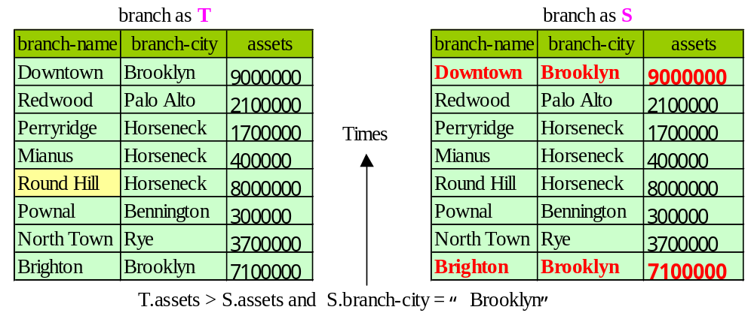

Slide 14
2. Query - String Operations
SQL includes a string-matching operator for comparisons on character strings. Patterns are described using two special characters:
  percent (%). The % character matches any substring.
  underscore ( _ ). The _ character matches any character.
e.g. Find the names of all customers whose street includes the substring “Main”.
    select customer-name
    From customer
    where customer-street like “%Main%” ;
  e.g. Match the name “Main%”
    like “Main\%” escape “\”

Slide 15
2. Query- Ordering the Display of Tuples
List in alphabetic order the names of all customers having a loan in Perryridge branch
    select distinct customer-name
    from borrower, loan
    where borrower loan-number = loan.loan-number and
    branch-name = “Perryridge”
    order by customer-name desc;
We may specify desc for descending order or asc for ascending order, for each attribute; ascending order is the default.
Notes:
oracle默认为 null 最大。
升序排列，默认情况下，null值排后面。
降序排序，默认情况下，null值排前面。
将sql语句改为
select * from test order by age desc nulls last;
即可将null值排到最后。”nulls last”将空值放在后面，相反的”nulls first”将空值记录放在前面

Slide 16
2. Query - Set Operations
The set operations union, intersect, and minus operate on relations correspond to the relational algebra operations union, intersect, and minus.
Each of the above operations automatically eliminates duplicates.
e.g. Find all customers who have a loan, an account, or both:
  (select customer-name from depositor)
  Union
  (select customer-name from borrower) ;

Slide 17
2. Query- Set Operations…
e.g. Find all customers who have both a loan and an account.
  select customer-name from depositor)
  Intersect
  (select customer-name from borrower) ;
e.g. Find all customers who have an account but no loan.
  (select customer-name from depositor)
  Minus
  (select customer-name from borrower) ;

Slide 18
2. Query - Aggregate Functions
These functions operate on the multiset of values of a column of a relation, and return a value.
  Avg( ): average value
  min ( ): minimum value
  max ( ): maximum value
  sum ( ): sum of values
  count (*): number of values
  COUNT(DISTINCT column-name): Determine the number of unique non-null values in a column

Slide 19
2. Query- Aggregate Functions…
e.g.Find the average account balance at the Perryridge branch.
select avg (balance)
from account
where branch-name = “Perryridge” ;
e.g. Find the number of tuples in the customer relation.
select count (*)
from customer ; count(*)计算所有行，包括空值；
e.g. Find the number of depositors in the bank.
    select count (distinct customer-name)
    from depositor ;
    当对一个包含NULL值的列使用COUNT函数时，这个列中的NULL值将会被去除掉。
Notes:
使用COUNT函数处理NULL值
大部分集合函数在进行计算时都去除NULL值，但COUNT函数是一个例外。一般情况下当对一个包含NULL值的列使用COUNT函数时，这个列中的NULL值将会被去除掉。但是如果COUNT函数使用一个星号，它就会计算所有的行，而不管其中是否包含NULL值。
如果你想使用COUNT函数计算包含NULL值的列的所有行，那么需要使用ISNULL函数（或使用NVL函数）。ISNULL函数能将一个NULL值以一个合法的值代替。
事实上，在有NULL值的情况下使用集合函数时，ISNULL函数是非常有用的。但记住当你使用星号时，COUNT函数将计算所有行。

Slide 20
2. Query-Aggregate Functions-Group By
e.g. Find the number of depositors for each branch.
  select branch-name, count (distinct customer-name)
  from depositor, account
  where depositor.account-number = account.account-number
  group by branch-name
Note: Attributes in select clause outside of aggregate functions must appear in group by list.
account (account-number, branch-name, balance)
depositor (customer-name, account-number)

Slide 21
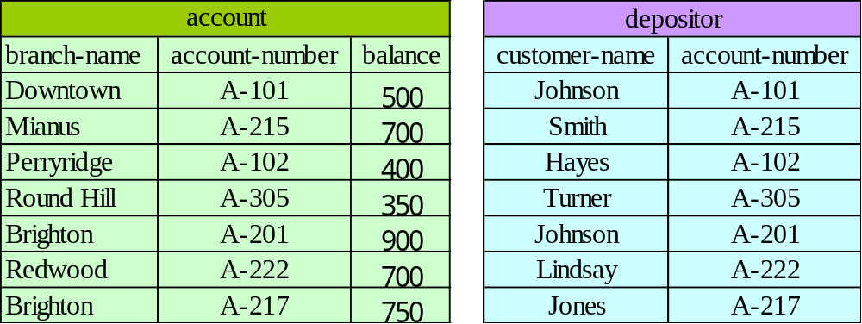
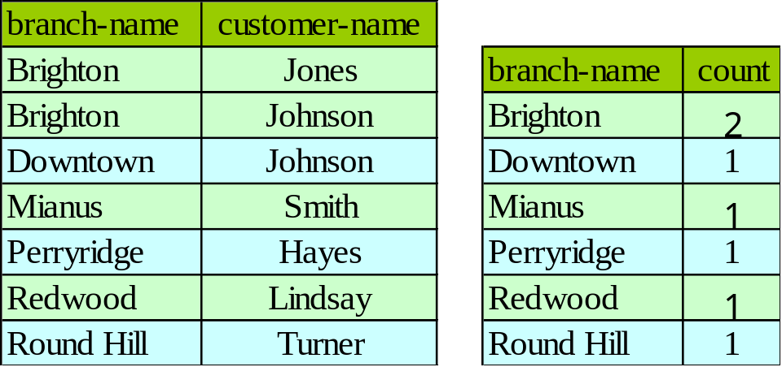
2. Query-Aggregate Functions-Group By
result

Slide 22
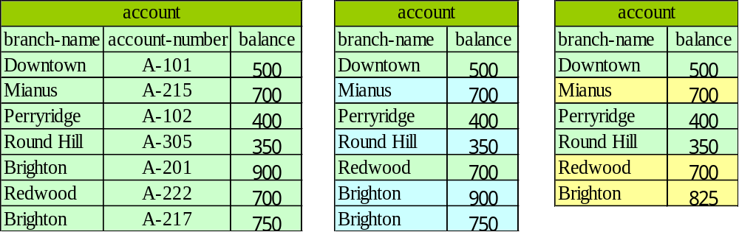
2. Query-Aggregate Functions - Having Clause
e.g. Find the names of all branches where the average account balance is more than $600.
  select branch-name, avg (balance)
  from account
  group by branch-name
  having avg (balance) > 600 ;
Note: predicates in the having clause are applied after the formation of groups.

Slide 23
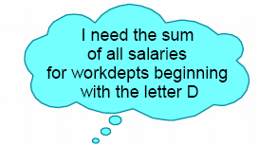



EMP and DEPT Example
SUM

Slide 24
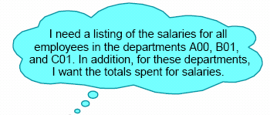
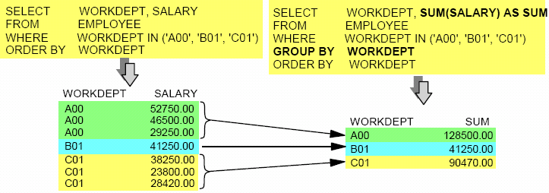
Group By
EMP and DEPT Example

Slide 25

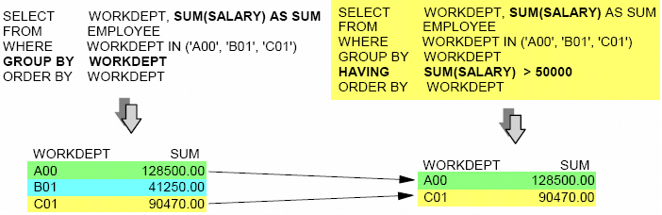
GROUP BY, HAVING
EMP and DEPT Example

Slide 26
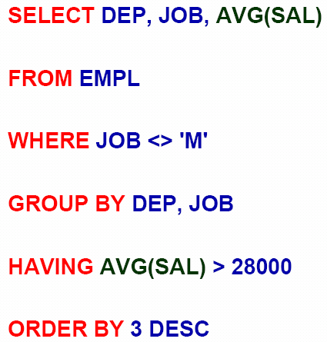

EMP and DEPT Example

Slide 27
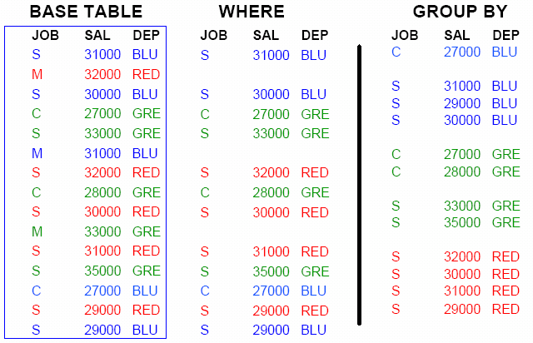
Conceptual Execution

Slide 28
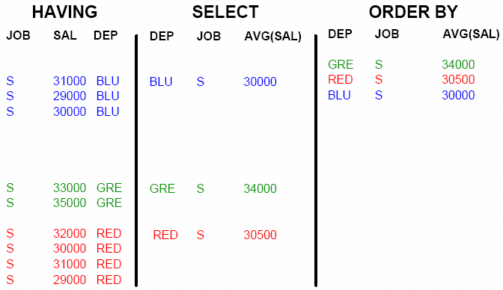
Conceptual Execution
Change AVG(SAL) to SUM(SAL)?

Slide 29
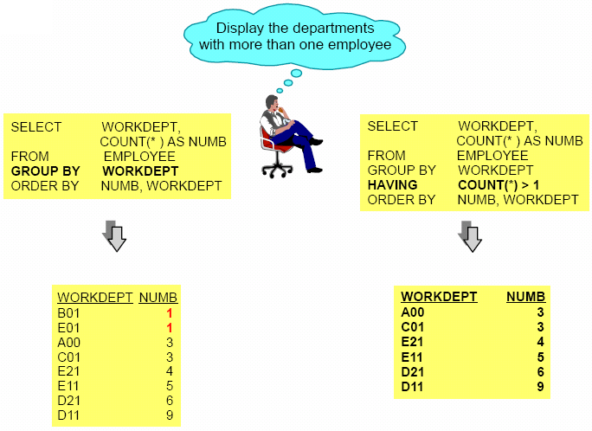
EMP and DEPT Example

Slide 30
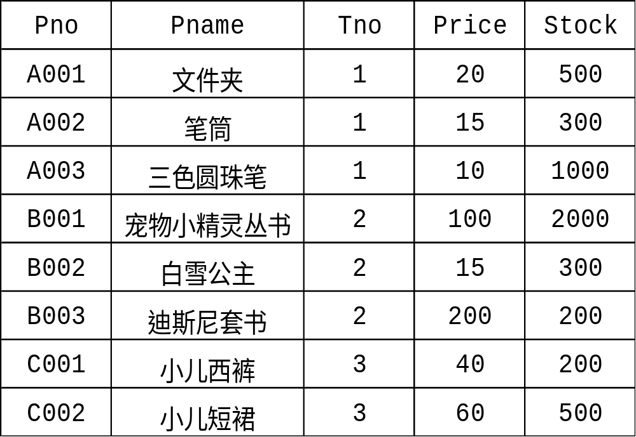
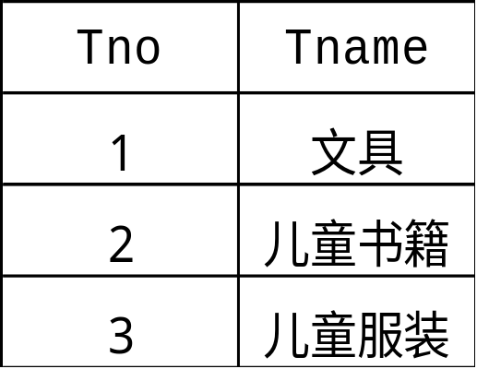
Product and Ptype Example
Product
Ptype

Slide 31
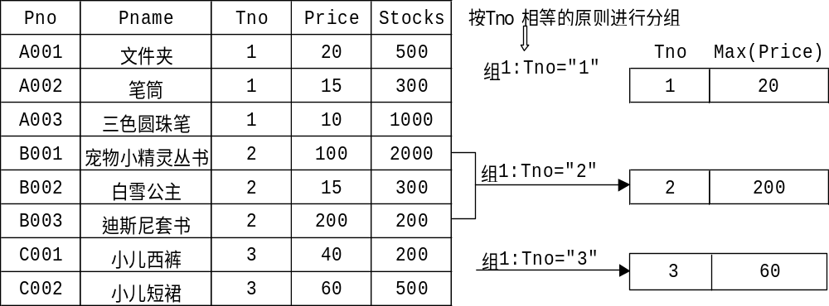
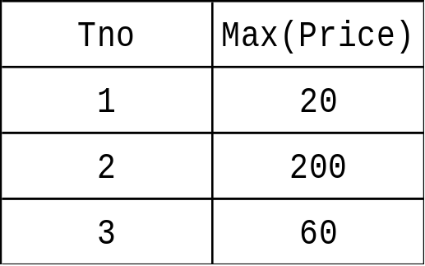
Product and Ptype Example
Find the maximal price of each types .
SELECT Tno,MAX(Price)
FROM Product
GROUP BY Tno;

Slide 32
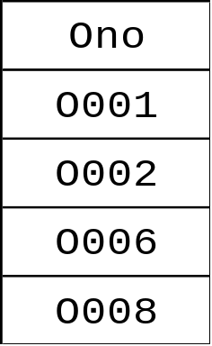
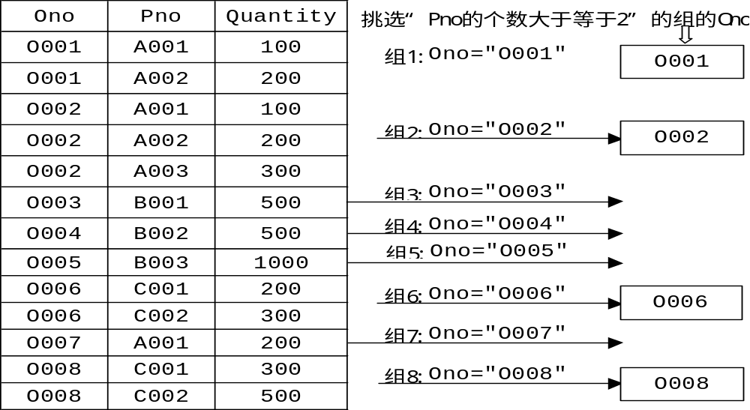
Product and Ptype Example
Find the number of all orders which ordered at least two products.
SELECT Ono
FROM Order_item
GROUP BY Ono
HAVING COUNT(Pno)>=2；

Slide 33
2. Query-Null Values
It is possible for tuples to have a null value, denoted by null, for some of their attributes, null signifies an unknown value or that a value does not exist.
The result of any arithmetic expression involving null is null.
Roughly speaking, all comparisons involving null return false.
More precisely,Any comparison with null returns unknown
  (unknown or unknown) = unknown,
  (true and unknown) = unknown,
  (false and unknown) = false,
  (unknown and unknown) = unknown
Note: Result of where clause predicate is treated as false if it evaluates to unknown

Slide 34
2. Query-Null Values…
e.g. Find all loan number which appear in the loan relation with null values for amount.
select loan-number
from loan
where amount is null ;
Total all loan amounts
select sum (amount)
from loan ;
Note: Above statement ignores null amounts; result is null if there is no non-null amount.
Note: All aggregate operations except count(*) ignore tuples with null values on the aggregated attributes.

Slide 35
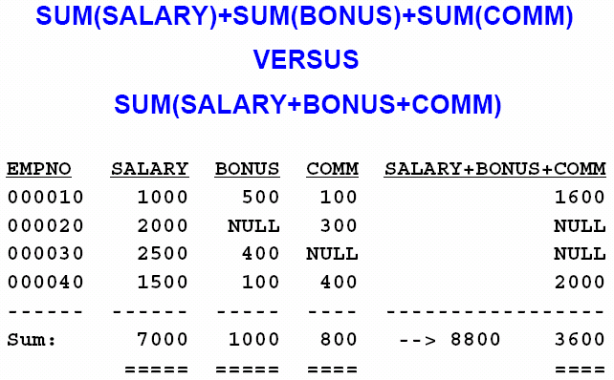
2. Query-Null Values…

Slide 36
2. Query- Nested Subqueries
SQL provides a mechanism for the nesting of subqueries.
A subquery is a select-from-where expression that is nested within another query.
A common use of subqueries is to perform tests for set membership and set comparisons.

Slide 37
2. Query- Nested Subqueries- Set Membership
F in r ⇔ ∃ t ∈ r (t = F)
0
4
(5 in
) = true
5
0
4
(5 in
) = false
6
0
(5 not in
4
) = true
6

Slide 38
2. Query- Nested Subqueries- Set Membership
e.g. Find all customers who have both an account and a loan at the bank.
  select distinct customer-name
  from borrower
  where customer-name in (select customer-name
  from depositor) ;
e.g. Find all customers who have a loan at the bank but do not have an account at the bank
  select distinct customer-name
  from borrower
  where customer-name not in (select customer-name
  from depositor) ;

Slide 39
2. Query- Nested Subqueries- Set Membership
e.g. Find all customers who have both an account and a loan at the North Town branch.
select distinct customer-name
from borrower, loan
where borrower.loan-number = loan.loan-number and
branch-name = “North Town ” and
(branch-name, customer-name) in
(select branch-name, customer-name
from depositor, account
where depositor.account-number =
account.account-number) ;
account (account-number, branch-name, balance)
loan (loan-number, branch-name, amount)
depositor (customer-name, account-number)
borrower (customer-name, loan-number)

Slide 40
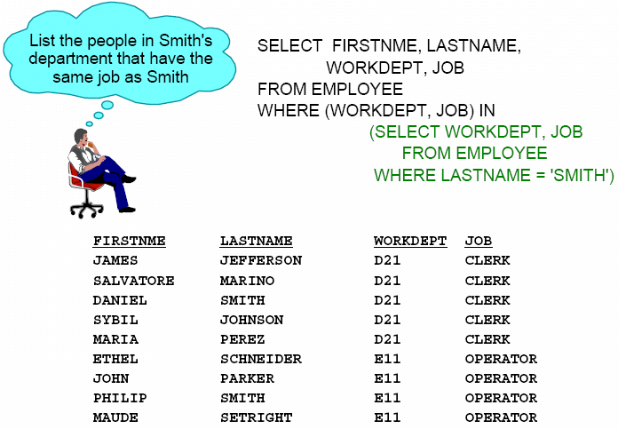
Subquery Using IN

Slide 41
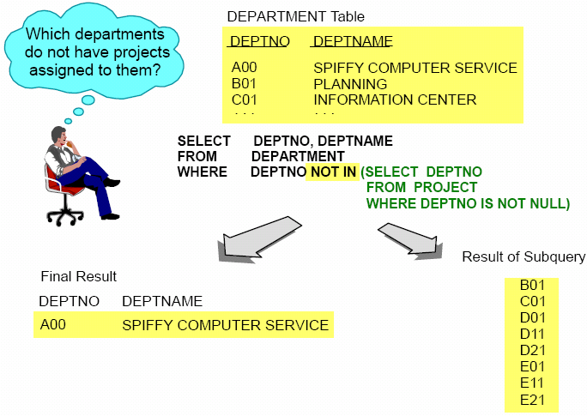
Subquery Using NOT IN

Slide 42
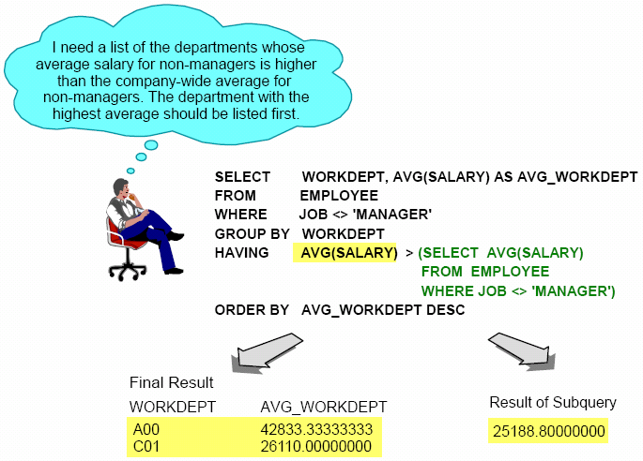
Subquery within HAVING Clause

Slide 43
2. Query- Nested Subqueries- The Some Clause
0
(5< some
5
) = true
(read: 5 < some tuple in the relation)
6
0
(5 = some
) = true
(= some) ≡ in
However, (≠ some) ≡ not in
5
0
(5 ≠ some
5
) = true (since 0 ≠ 5)

Slide 44
2. Query- Nested Subqueries- Set Comparison
e.g. Find all branches that have greater assets than some branch located in Brooklyn.
  select distinct T.branch-name
  from branch as T, branch as S
  where T.assets > S.assets and
  S.branch-city = “Brooklyn” and
  T.branch-city <> “Brooklyn;

Slide 45
2. Query- Nested Subqueries- The Some Clause
e.g. Find all branches that have greater assets than some branch located in Brooklyn.
select branch-name
from branch
where assets >some
(select assets
from branch
where branch-city = “Brooklyn” );
??

Slide 46
2. Query- Nested Subqueries- The All Clause
0
(5< all
) = false
5
6
6
(5< all
) = true
10
4
(5 = all
) = false
5
4
(5 ≠ all
) = true (since 5 ≠ 4 and 5 ≠ 6)
6

Slide 47
2. Query- Nested Subqueries- The All Clause
e.g. Find the names of all branches that have greater assets than all branches located in Brooklyn.
select branch-name
from branch
where assets > all
(select assets
from branch
where branch-city = “Brooklyn”) ;

Slide 48
2. Query- Test for Empty Relations
The exists construct returns the value true if the argument subquery is nonempty.
带有EXISTS 和 NOT EXISTS谓词的查询的子查询不返回任何数据，只返回逻辑真和假.
exists r ⇔ r ≠ Ø
  not exists r ⇔ r = Ø

Slide 49
2. Query- Test for Empty Relations
查询所有选修了1号课程的学生姓名
Select Sname
from Student
where Exists
( select *
from SC
Where Sno=Student.Sno and Cno=‘1’);
由exists引出的子查询，其目标列表达式通常都用*
子查询的查询条件依赖于父查询的某个属性值（相关子查询）
反复求值
不能被其他形式的子查询等价替换
学生表：Student(Snumber,Sname,Ssex,Sage,Sdept)
课程表: Course(Cno,Cname,Cpno,Ccredit)
学生选课表:SC (Sno,Cno,Grade)

Slide 50
2. Query- Test for Empty Relations
查询没有选修了1号课程的学生姓名
Select Sname
from Student
where not Exists
( select *
from SC
Where Sno=Student.Sno and Cno=‘1’);
学生表：Student(Snumber,Sname,Ssex,Sage,Sdept)
课程表: Course(Cno,Cname,Cpno,Ccredit)
学生选课表:SC (Sno,Cno,Grade)

Slide 51
2. Query- Test for Empty Relations
查询选修了全部课程的学生姓名
Select Sname
from Student
where not exists
(select *
from Course
where not exists
(select *
from SC
where Sno=Student.Sno
and Cno=Course.Cno));
把全称量词转换成等价的使用存在量词的形式。
==〉没有一门课程是他不选修的。
Sno不选的所有课
Sno 不选的某个课
学生表：Student(Snumber,Sname,Ssex,Sage,Sdept)
课程表: Course(Cno,Cname,Cpno,Ccredit)
学生选课表:SC (Sno,Cno,Grade)

Slide 52
Product and Ptype Example
Product
Ptype

Slide 53
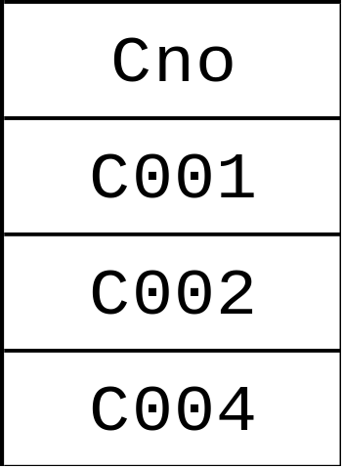
Product and Ptype Example
Find the number of all orders which ordered “A001 ” product.
SELECT DISTINCT Ono
FROM Order
WHERE EXISTS
(SELECT *
FROM Order_item
WHERE Ono=Order.Ono AND
Pno="A001")；

Slide 54
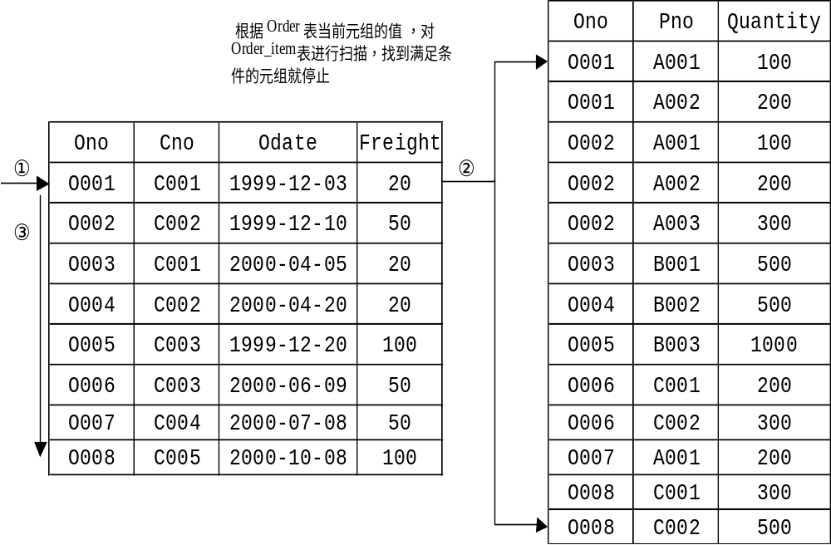
Product and Ptype Example

Slide 55
Product and Ptype Example
Find the number of all orders which didn’t order “A001 ” product.
SELECT DISTINCT Ono
FROM Order
WHERE NOT EXISTS
(SELECT *
FROM Order_item
WHERE Ono=Order.Ono AND
Pno="A001")；

Slide 56
2. Query- Test for Empty Relations
e.g. Find all customers who have an account at all branches located in Brooklyn.
  select distinct S.customer-name
  from depositor as S
  where not exists (
  (select branch-name
  from branch
  where branch-city = “Brooklyn”)
  minus
    (select R.branch-name
    from depositor as T, account as R
    where T.account-number = R.account-number and
    S.customer-name = T.customer-name) );
// Find branch-name located in “Brooklyn”)
// Find S.customer-name’s branch-name
Note: X minus Y = Ø ⇔ X ⊆ Y

Slide 57
3. Modification– Deletion
e.g. Delete all account records at the Perryridge branch.
  delete from account
  where branch-name = “Perryridge” ;
e.g. Delete all accounts at every branch located in Needham.
delete from depositor
where account-number in
(select account-number
from branch, account
where branch-city = “Needham”
and branch.branch-name = account.branch-name) ;
delete from account
where branch-name in (select branch-name
from branch
where branch-city = “Needham”) ;
  //The order is important

Slide 58
3. Modification– Deletion
e.g. Delete the record of all accounts with balances below the average at the bank.
delete from account
where balance < (select avg (balance)
from account) ;
  Problem: as we delete tuples from deposit, the average balance changes
  Solutions used in SQL:
  1.First, compute avg balance and find all tuples to delete
  2.Next, delete all tuples found above (without recomputing avg or retesting the tuples)

Slide 59
3. Modification– Insertion
e.g. Add a new tuple to account.
insert into account
values (A-9732 ,”Perryridge”,1200) ;
insert into account (branch-name, balance, account-number)
values (“Perryridge”, 1200, A-9732) ;
e.g. Add a new tuple to account with balance set to null.
insert into account
values (A-777, “Perryridge”, null)

Slide 60
3. Modification– Insertion
e.g. Provide as a gift for all loan customers of the Perryridge branch, a $200 savings account. Let the loan number serve as the account number for the new savings account
insert into account
select loan-number,branch-name, 200
from loan
where branch-name = “Perryridge” ;
insert into depositor
select customer-name, loan-number
from loan, borrower
where branch-name = “Perryridge” and
loan.loan-number = borrower.loan-number ;

Slide 61
3. Modification – Updates
e.g Increase all accounts with balances over $10,000 by 6%, all other accounts receive 5%.
Write two update statements:
  update account
  set balance = balance ∗ 1.06
  where balance > 10000 ;
  update account
  set balance = balance ∗ 1.05
  where balance <=10000 ;
  NOTE: The order is important.

Slide 62
4. Data Definition -Create Table
An SQL relation is defined using the create table command:
create table R (A₁ D₁, A₂ D₂, ..., A_{n} D_{n},
(integrity-constraint₁),...,(integrity-constraint_{k})) ;
  R is the name of the relation
  each A_{i} is an attribute name in the schema of relation R
  D_{i} is the data type of values in the domain of attribute A_{i}
e.g.
create table branch
(branch-name char(15) not null,
branch-city char(30),
assets integer) ;

Slide 63
4. Data Definition -Create Table
Integrity Constraints
not null
primary key (A₁, ..., A_{n})
check (P), where P is a predicate
e.g. Declare branch-name as the primary key for branch and ensure that the values of assets are non-negative.
create table branch
(branch-name char(15),
branch-city char(30),
assets integer,
primary key (branch-name),
check (assets > = 0)) ;
NOTE:primary key declaration on an attribute automatically
ensures not null in SQL-92

Slide 64
4. Data Definition - Drop and Alter Table
The drop table command deletes all information about the dropped relation from the database.
drop table emp
The alter table command is used to add attributes to an existing relation.
alter table R add A D
  A is the name of the attribute to be added to relation R and D is the domain of A.
  All tuples in the relation are assigned null as the value for the new attribute.
The alter table command can also be used to drop attributes of a relation
alter table R drop A
  A is the name of an attribute of relation R

Slide 65
4. Data Definition - Views
Provide a mechanism to hide certain data from the view of certain users.
create view v as <query expression>
  <query expression> is any legal expression
  The view name is represented by v

Slide 66
4. Data Definition - Views
Create a view consisting of branches and their customers
  create view all-customer as
  (select branch-name, customer-name
  from depositor, account
  where depositor account-number =account.account-number)
  union
  (select branch-name, customer-name
  from borrower, loan
  where borrower.loan-number = loan.loan-number) ;
Find all customers of the Perryridge branch
select customer-name
from all-customer
where branch-name = “Perryridge”

Slide 67
4. Data Definition - Views
Create a view of all loan data in loan relation, hiding the amount attribute
create view branch-loan as
select branch-name, loan-number
from loan ;
Add a new tuple to branch-loan
insert into branch-loan
values (“Perryridge”,” L-307”) ;
insert into loan
values(“Perryridge”, “L-307, null) ;
Updates on more complex views are difficult or impossible to translate, and hence are disallowed.

Slide 68
4. Data Definition - Views
DB2不允许更新视图规定：
１ 视图由两个以上基本表导出
２ 视图字段来自字段表达式或常数，不可执行insert和update，但允许执行delete
３ 视图字段来自聚集函数
４ 视图中含group by
５ 视图中含distinct
６ 视图定义中含有嵌套查询；
７ 不允许更新的视图上定义的视图

Slide 69
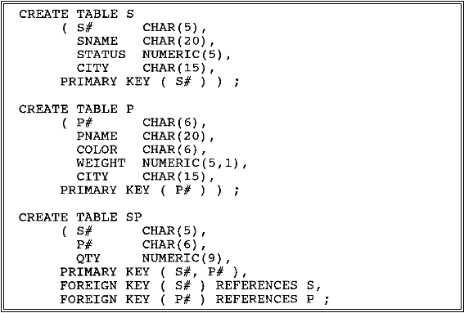
More Examples

Slide 70
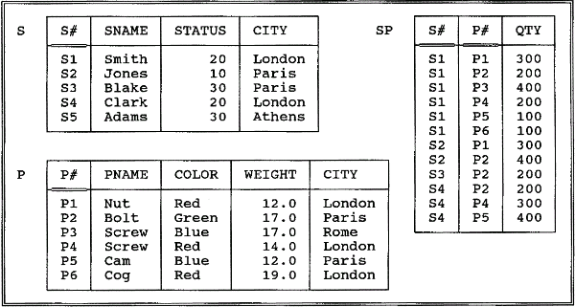
More Examples

Slide 71



More Examples
7.7.1 Get color and city for "nonParis" parts with weight greater than ten pounds.
7.7.2 For all parts, get the part number and the weight of that part in grams.
7.7.3 Get all combinations of supplier and part information such that the supplier and part in question are colocated.

Slide 72
More Examples
7.7.4 Get all pairs of city names such that a supplier located in the first city supplies a part stored in the second city.
select distinct s.city as scity, p.city as pcity
from s,sp,p
where s.s#=sp.s# and sp.p#=p.p#
Note: The following is not correct (because it includes CITY as a joining column in the second join):

Slide 73


More Examples
7.7.5 Get all pairs of supplier numbers such that the two suppliers concerned are colocated.
7.7.6 Get the total number of suppliers.

Slide 74


More Examples
7.7.7 Get the maximum and minimum quantity for part P2.
7.7.8 For each part supplied, get the part number and the total shipment quantity.

Slide 75


More Examples
7.7.9 Get part numbers for parts supplied by more than one supplier.
7.7.10 Get supplier names for suppliers who supply part P2.

Slide 76
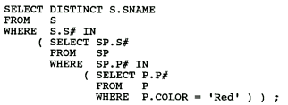
More Examples
7.7.11 Get supplier names for suppliers who supply at least one red part.

Slide 77


More Examples
7.7.12 Get supplier numbers for suppliers with status less than the current maximum status in the S table.
7.7.13 Get supplier names for suppliers who supply part P2.

Slide 78
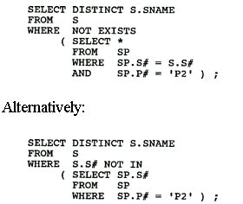
More Examples
7.7.14 Get supplier names for suppliers who do not supply part P2.

Slide 79
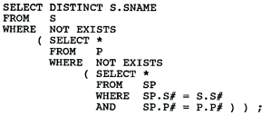
More Examples
7.7.15 Get supplier names for suppliers who supply all parts.

Slide 80
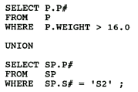
More Examples
7.7.16 Get part numbers for parts that either weigh more than 16 pounds or are supplied by supplier S2, or both.

Slide 81
Group project—section 3
Analyze the common query requirements (operations) based on your application background.
Do you need some views in your background? why? What is their functions?
Express them in SQL language.

